Slide 1



Module 7
More on XSLT

Slide 2


Module Overview
In this module, you will learn about:
XPath
XPath Expressions and Functions
Working with different Styles

Slide 3


XPath
XPath can be considered as a query language like SQL.
Extracts information from an XML document.
Used to navigate through elements and attributes in an XML document.
Allows identifying parts of an XML document.
Provides a common syntax for features shared by Extensible
Stylesheet Language Transformations (XSLT) and XQuery.
XSLT
Language for transforming XML documents into XML, HTML or text.
XQuery
Builds on XPath.
Language for extracting information from XML documents.

Slide 4


Benefits of XPath
Provides single syntax that you can use for:
Queries
Addressing
Patterns
Concise, simple, and powerful.
Benefits:
Syntax is simple for the simple and common cases.
Any path that can occur in an XML document.
Any set of conditions for the nodes in the path can be specified.
Any node in an XML document can be uniquely identified.

Slide 5


XML Document in XPath 1-4
An XML document is viewed as a tree.
Each part of the document is represented as a node.
Nodes
Root
A single root node that contains all other nodes in the tree.
Element
Every element in a document has a corresponding element node that appears in the tree under the root node.
Within an element node appear all of the other types of nodes
that correspond to the element’s content.
Element nodes may have a unique identifier associated with them that is used to reference the node with XPath.

Slide 6

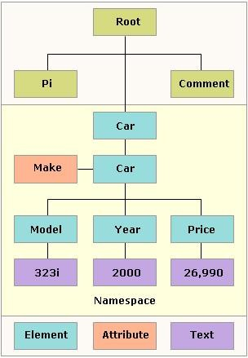
XML Document in XPath 2-4

Slide 7

XML Document in XPath 3-4
Attribute
Each element node has an associated set of attribute nodes.
Element is the parent of each of these attribute nodes.
An attribute node is not a child of its parent element.
Text
Character data is grouped into text nodes.
Characters inside comments, processing instructions and attribute
values do not produce text nodes.
The text node has a parent node and it may be the child node.
Comment
There is a comment node for every comment, except within the
document type declaration (DTD).
The comment node has a parent node and it may be the child node too.

Slide 8


XML Document in XPath 4-4
Processing instruction
Processing instruction node exists for every processing instruction except for any processing instruction within the document type declaration.
The processing instruction node has a parent
node and it may be the child node too.
Namespace
Each element has an associated set of
namespace nodes.
Provides descriptive information about their
parent node.

Slide 9

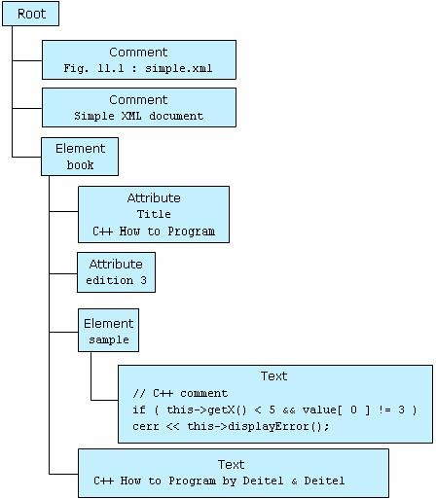
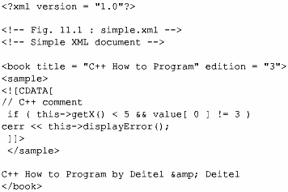
XPath Representation
An XPath query operates on a well-formed XML document after it
has been parsed into a tree structure.
Original XML Document
XPath Representation

Slide 10
Operators in XPath
An XPath expression returns a node set, a boolean, a string, or
a number.
XPath provides basic floating point arithmetic operators and some comparison and boolean operators.
Operator | Description
/ | Child operator; selects immediate children of the left-side collection.
// | Recursive descent; searches for the specified element at any depth
. | Indicates the current context
.. | The parent of the current context node
* | Wildcard; selects all elements regardless of the element name
@ | Attribute; prefix for an attribute name
: | Namespace separator; separates the namespace prefix from the element or attribute name

Slide 11
Examples of XPath Operators
Expression | Refers to
Author/FirstName | All <FirstName> elements within an <Author> element of the current context node.
BookStore//Title | All <Title> elements one or more levels deep in the <BookStore> element.
BookStore/*/Title | All <Title> elements that are grandchildren of <BookStore> elements.
BookStore//Book/Excerpt//Work | All <Work> elements anywhere inside <Excerpt> children of <Book> elements, anywhere inside the <BookStore> element.
.//Title | All <Title> elements one or more levels deep in the current context.

Slide 12
Types of Matching 1-3
XPath can create of the patterns.
The match attribute of the xsl:template element
supports a complex syntax.
Allows to express exactly which nodes to be matched.
The select attribute of xsl:apply-templates, xsl:value-of, xsl:for-each, xsl:copy-of, and xsl:sort supports a superset of the syntax.
Allows to express exactly which nodes to selected
and which nodes not to be selected.

Slide 13
Types of Matching 2-3
Matching by name
The source element is identified by its name, using the match attribute.
The value given to the match attribute is called the pattern.
Code Snippet
 | <xsl:template | match |  | = | “Greeting”>
Matches all greeting elements in the source document.
Matching by ancestry
As in CSS, a match can be made using the element’s ancestry.
Code Snippet
<xsl:template match = “P//EM”>
Matches any ‘EM’ element that has ‘P’ as an ancestor.
Matching the element names
The most basic pattern contains a single element name which matches all elements with that name.
Code Snippet
<xsl:template match=”Product”> <xsl:value-of select=”Product_ID”/> </xsl:template>
Matches Product elements and marks
their Product_ID children bold.

Slide 14
Types of Matching 3-3
Matching the root
Enables all descendant nodes to inherit the properties on the root of document.
Uses a single forward slash to represent the root.
Code Snippet
<xsl:template match = “/”>
Selects the root pattern.
Matching by attribute
As in CSS, a match can be made using the element’s ancestry.
Uses square brackets to hold the attribute name and value.
Syntax
 | <xsl:template match = “ element name[‘attribute’ (attribute-name)=attribute-value]”>
Code Snippet
<xsl:template match=”Product”>
<xsl:apply-templates select=”@Units”/>
</xsl:template>
Applies the templates to the non-existent Units attributes of Product elements.

Slide 15


XPath Expressions 1-2
Statements that can extract useful information from the XPath tree.
Instead of just finding nodes, one can count them, add up numeric values, compare strings, and more.
Are like statements in a functional programming language.
Evaluates to a single value.

Slide 16
XPath Expressions 2-2
Node-set
An unordered group of nodes from the input document that match
an expression’s criteria.
Boolean
XSLT allows any kind of data to be transformed into a boolean.
Often done implicitly when a string or a number or a node-set is used where a boolean is expected.
Number
Numeric values useful for counting nodes and performing simple arithmetic.
Numbers like 43 or –7000 that look like integers are stored as doubles.
Non-number values, such as strings and booleans, are converted
to numbers automatically as necessary.
String
A sequence of zero or more Unicode characters.
Other data types can be converted to strings using the string()
function.

Slide 17
XPath Functions
XPath defines various functions required for XPath 2.0, XQuery
1.0 and XSLT 2.0.
The different functions are Accessor, AnyURI, Node, Error and Trace, Sequence, Context, Boolean, Duration/Date/Time, String, QName and Numeric.
Can be used to refine XPath queries and enhance the
programming power and flexibility of XPath.
Each function in the function library is specified using a function prototype that provides the return type, function name, and argument type.
If an argument type is followed by a question mark, the
argument is optional; otherwise, the argument is required.
Function names are case-sensitive.
The default prefix for the function namespace is fn.
Notes:
Refine : loc

Slide 18
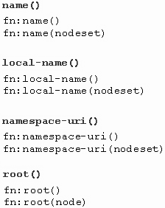
Node-Set Functions 1-4
Take a node-set argument.
Return a node-set or information about a particular node within a
node-set.
Are name(), local-name(), namespace-uri() and root().
Syntax
where,
name(): Returns name of current node or
the first node in specified node set.
local-name(): Returns name of current node or the first node in specified node set
– without namespace prefix.
namespace-uri(): Returns namespace URI of current node or first node in specified node set.
root(): Returns root of tree to which the current node or specified node belongs. This will usually be a document node.

Slide 19
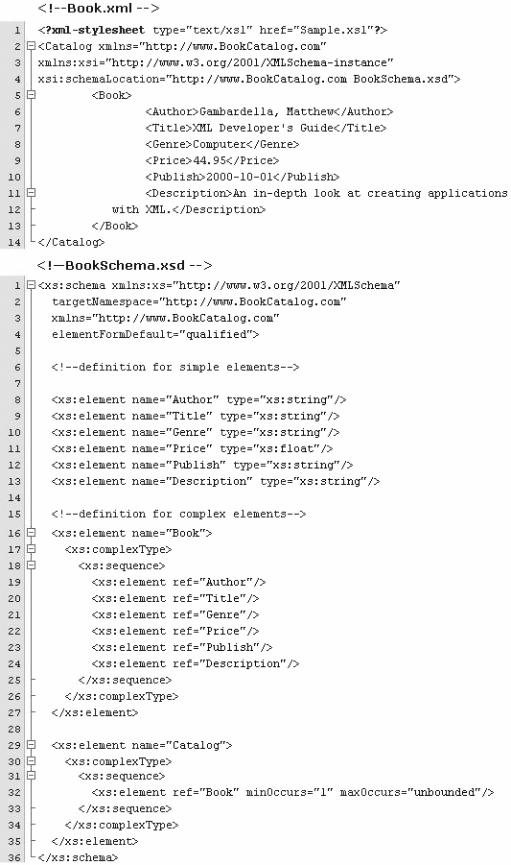
Node-Set Functions 2-4
Code and Schema

Slide 20
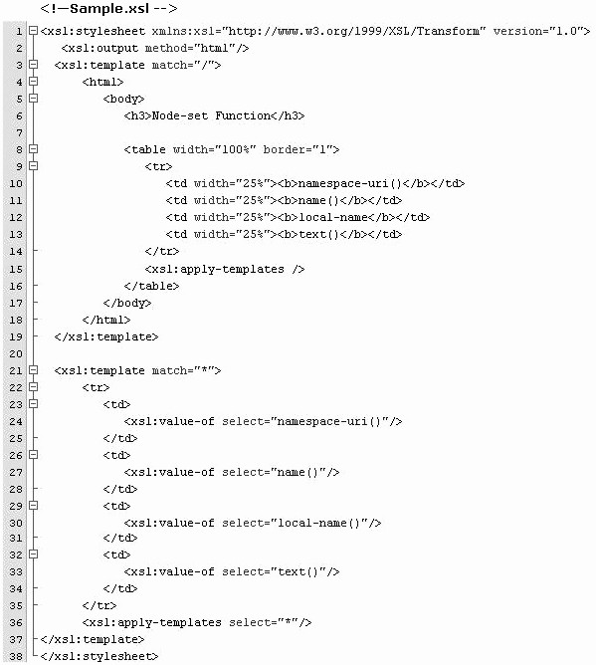
Node-Set Functions 3-4
Stylesheet
Modern Markup for

Slide 21
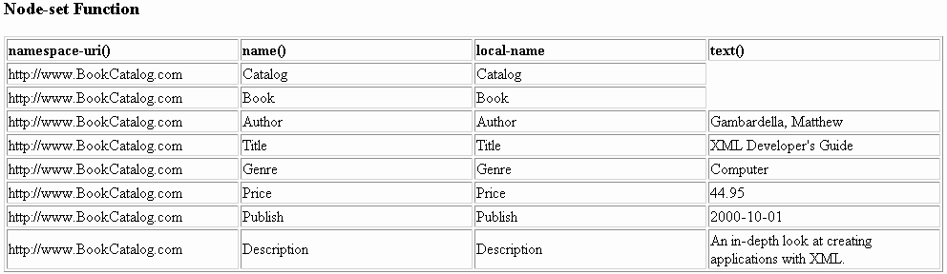
Node-Set Functions 4-4
Formatted Output

Slide 22

Boolean Functions 1-5
boolean(arg)
Returns a boolean value for a number, string, or node-set.
Syntax
fn:boolean(arg)
Code Snippet
 | <ul> <li><b>boolean(0)</b> = <xsl:value-of select=”boolean(0)”/></li> <li><b>boolean(1)</b> = <xsl:value-of select=”boolean(1)”/></li> <li><b>boolean(-100)</b> = <xsl:value-of select=”boolean(-100)”/></li> <li><b>boolean(‘hello’)</b> = <xsl:value-of select=”boolean(‘hello’)”/></li> <li><b>boolean(‘’)</b> = <xsl:value-of select=”boolean(‘’)”/></li> <li><b>boolean(//book)</b> = <xsl:value-of select=”boolean(//book)”/></li> </ul>
boolean(0) = false boolean(1) = true boolean(-100) = true boolean(‘hello’) = true boolean(‘’) = false boolean(//book) = false
@ Aptech Limited
Modern Markup for Data Interchange/ Module 7/ 25 of 51

Slide 23
Boolean Functions 2-5
not(arg)
The sense of an operation can be reversed by using the
not() function.
Syntax
fn:not(arg)

Slide 24

Boolean Functions 3-5
not(arg)
The sense of an operation can be reversed by using the
not() function.
Code Snippet
<xsl:template match=”PRODUCT[not(position()=1)]”>
<xsl:value-of select=”.”/>
</xsl:template>
The template rule selects all product elements that are not the first child of their parents.
Code Snippet
<xsl:template match=”PRODUCT[position()!=1]”>
<xsl:value-of select=”.”/>
</xsl:template>
The same template rule could be written using the not equal operator != instead.

Slide 25

Boolean Functions 4-5
true()
Returns the boolean value true.
Syntax
fn:true()
Code Snippet
<xsl:value-of select=”true()”/>
true

Slide 26

Boolean Functions 5-5
false()
Returns the boolean value true.
Syntax
fn:false()
Code Snippet
<xsl:value-of select=”false() or false()”/>
<xsl:value-of select=”true() and false()”/>
<xsl:value-of select=”false() and false()”/>
true false false

Slide 27
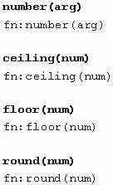
Numeric Functions 1-5
Return strings or numbers.
Can be used with comparison operators in filter patterns such as:
number(arg)
ceiling(num)
floor(num)
round(num)
Syntax
where,
number(arg): Returns numeric value of
argument. Argument could be a boolean, a string, or a node-set.
ceiling(num): Returns smallest integer greater than the number argument.
floor(num): Returns largest integer that is not greater than the number argument.
round(num): Rounds the number argument to the nearest integer.

Slide 28
Numeric Functions 2-5
Stylesheet(1-3)
<?xml version=”1.0”?>
<?xml-stylesheet type=”text/xsl” href=”Number.xsl”?>
<xsl:stylesheet version=”1.0” xmlns:xsl=”http://www.w3.org/1999/XSL/Transform”>
<xsl:output method=”html”/>
<xsl:template match=”/”>
<html>
<body>
<h3>Numeric Functions</h3>
<ul>
<li>
<b>number(‘1548’)</b> =
<xsl:value-of select=”number(‘1548’)”/>
</li>
<li>
<b>number(‘-1548’)</b> = <xsl:value-of select=”number(‘-1548’)”/>
</li>
<li>
<b>number(‘text’)</b> = <xsl:value-of select=”number(‘text’)”/>
</li>
<li>
<b>number(‘226.38’ div ‘1’)</b> = <xsl:value-of select=”number(‘226.38’
div ‘1’)”/>
</li>
</ul>

Slide 29

Numeric Functions 3-5
Stylesheet(2-3)
<ul>
<li>
<b>ceiling(2.5)</b> = <xsl:value-of select=”ceiling(2.5)”/>
</li>
<li>
<b>ceiling(-2.3)</b> = <xsl:value-of select=”ceiling(-2.3)”/>
</li>
<li>
<b>ceiling(4)</b> = <xsl:value-of select=”ceiling(4)”/>
</li>
</ul>
<ul>
<li>
<b>floor(2.5)</b> = <xsl:value-of select=”floor(2.5)”/>
</li>
<li>
<b>floor(-2.3)</b> = <xsl:value-of select=”floor(-2.3)”/>
</li>
<li>
<b>floor(4)</b> = <xsl:value-of select=”floor(4)”/>
</li>
</ul>

Slide 30


Numeric Functions 4-5
Stylesheet(3-3)
<ul>
<li>
<b>round(3.6)</b> = <xsl:value-of select=”round(3.6)”/>
</li>
<li>
<b>round(3.4)</b> = <xsl:value-of select=”round(3.4)”/>
</li>
<li>
<b>round(3.5)</b> = <xsl:value-of select=”round(3.5)”/>
</li>
<li>
<b>round(-0.6)</b> = <xsl:value-of select=”round(-0.6)”/>
</li>
<li>
<b>round(-2.5)</b> = <xsl:value-of select=”round(-2.5)”/>
</li>
</ul>
</body>
</html>
</xsl:template>
</xsl:stylesheet>

Slide 31

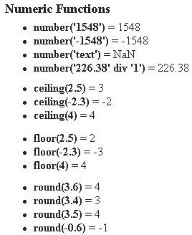
Numeric Functions 5-5
Output

Slide 32
String Functions 1-5
String functions are used to:
Evaluate
Format and manipulate string arguments
Convert an object to a string
Different String functions are:
string(arg)
compare()
concat()
substring()

Slide 33
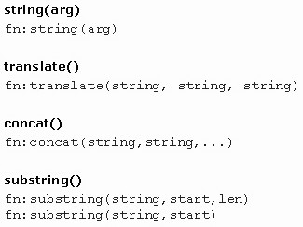
String Functions 2-5
Syntax
where,
string(arg): Returns string value of
the argument. The argument could be a number, boolean, or node- set.
translate(): Returns first argument string with occurrences of characters in second argument string replaced by character at the corresponding position in third argument string.
concat(): Returns concatenation of
the strings.
substring(): Returns substring from the start position to specified length.

Slide 34
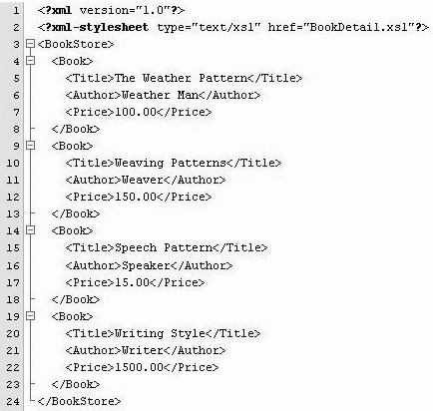
String Functions 3-5
Code Snippet

Slide 35
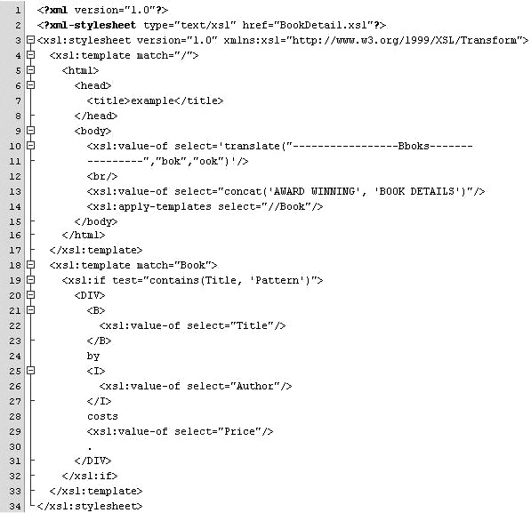
String Functions 4-5
Stylesheet

Slide 36

String Functions 5-5
Output

Slide 37
Result Tree Fragments
A portion of an XML document that is not a complete node or set of nodes.
The only allowed operation in a result tree fragment is on a string.
The operation on the string may involve first converting the string to a number or a boolean.
Result tree fragment is an additional data type other than four basic XPath data types, such as, string, number, boolean, node-set.
A result tree fragment represents a fragment of the result tree.
It is not permitted to use the /, //, and [] XPath operators on Result tree fragments.

Slide 38
Transformation of XML Document 1-2
Transformation is one of the most important and useful
techniques for working with XML.
XML can be transformed by changing its structure, its markup, and perhaps its content into another form.
The most common reason to transform XML is to extend the reach of a document into new areas by converting it into a presentational format.
Uses of transformation:
Formatting a document to create a high-quality presentational format.
Changing one XML vocabulary to another.
Extracting specific pieces of information and formatting them in another way.
Changing an instance of XML into text.
Reformatting or generating content.

Slide 39
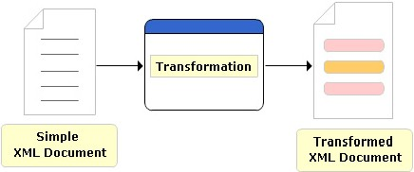
Transformation of XML Document 2-2

Slide 40
Transformation using XSLT Processor 1-2
Takes two inputs:
An XSLT stylesheet to govern the transformation process.
An input document called the source tree.
The output is called the result tree.
The XSLT engine begins by reading in the XSLT stylesheet and caching it as a look-up table.
XPath locates the parts of XML document such as Element
nodes, Attribute nodes and Text nodes.
For each node the XSLT processes, it will look in the table for the best matching rule to apply.
Starting from the root node, the XSLT engine finds rules, executes them, and continues until there are no more nodes in its context node set to work with.
At that point, processing is complete and the XSLT engine outputs the result document.

Slide 41
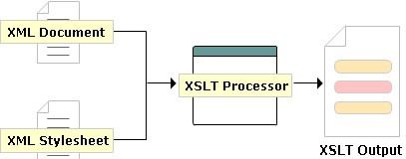
Transformation using XSLT Processor 2-2

Slide 42
Transforming XML using XSLT 1-2
Step 1
Creates a normal XML document.
Code Snippet
<?xml version=”1.0” encoding=”UTF-8”?>
Step 2
Add the following lines.
Code Snippet
<?xml version=”1.0” encoding=”ISO-8859-1”?>
<xsl:stylesheet xmlns:xsl=”http://www.w3.org/1999/XSL/Transform” version=”1.0” >
...
</xsl:stylesheet>
Step 3
Set it up to produce HTML-compatible output.
The <xsl:output> tag should be used with either “text” or “html” to output
anything besides well-formed XML.
The default value is “xml”.
Code Snippet
<xsl:stylesheet>
<xsl:output method=”html”/>
...
</xsl:stylesheet>

Slide 43
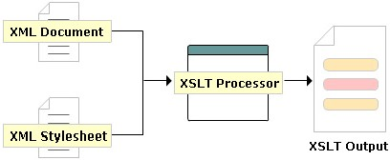
Transforming XML using XSLT 2-2

Slide 44
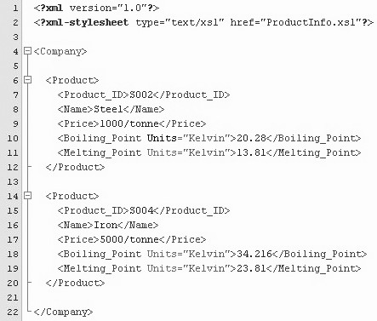
Transforming XML using XSLT Example 1-2
Example code of transforming XML documents into HTML using XSLT
processor
Code Snippet
where,
Company: The root Company element contains Product child elements.
Units: Attribute specifies the units for products melting point and boiling point.

Slide 45
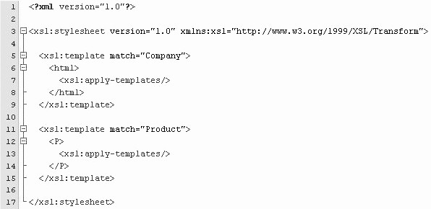

Transforming XML using XSLT Example 2-2
Stylesheet
Output

Slide 46
Summary 1-2
XPath
Notation for retrieving information from a document.
Provides a common syntax for features shared by Extensible Stylesheet Language Transformations (XSLT) and XQuery.
Have seven types of node as Root, Element, Attribute, Text, Comment, Processing instruction and Namespace.
Used in the creation of the patterns.
XPath Expressions and Functions
The four types of expressions in XPath are
Node-sets.
Booleans.
Numbers.
Strings.

Slide 47
Summary 2-2
XPath Expressions and Functions (contd...)
Functions defined for XPath are Accessor, AnyURI, Node, Error and Trace, Sequence, Context, Boolean, Duration/Date/Time, String, QName and Numeric.
A Result tree fragment is a portion of an XML document that is not a complete node or set of nodes.
Working with different styles
Transformation is one of the most important and useful techniques for working with XML.
To transform XML is to change its structure, its markup,
and perhaps its content into another form.
Transformation can be carried out using an XSLT processor also.

